Slide 1
NYC yellow TAXi price prediction ds-610-big data analytics Professor Name: Metin Senturk
Lakshmi Prasanthi
Keerthi
Pavithra
Notes:
Are your classroom colors different than what you see in this template? That’s OK! Click on Design -> Variants (the down arrow) -> Pick the color scheme that works for you!
Feel free to change any “You will…” and “I will…” statements to ensure they align with your classroom procedures and rules!

Slide 2
Agenda:
Introduction
Problem Statement
Dataset-Description
Data Preprocessing steps
Data Type Schema
Data Visualization
Correlation-Heat Map
Train and Test Dataset
Feature and Label Columns
Machine Learning Models
Summary Results
Conclusion

Slide 3
Introduction:
The main important role of taxis in modern transportation systems by providing a flexible, convenient, and accessible mode of transportation for people and businesses alike. With the help of machine learning technology, taxi companies can optimize their services and improve the efficiency and effectiveness of this important transportation option.
Machine learning algorithms can analyze large amounts of historical data and provide insights that can inform decision making on taxi data. This can help us make more informed decisions about predicting patterns, pricing, route optimization, and other key factors that can impact the transportation.

Slide 4
Problem Statement:
The expected outcome of this project using a machine learning techniques that can predict the total amount charged for taxi trips in New York City based on various input features(Passenger Count, Trip Distance, Fare amount , Tip amount, Tolls amount…).
Machine learning models can help taxi companies optimize their pricing strategies and improve their revenue by predicting the fare amount for future taxi trips.

Slide 5
Dataset-Description:
The size of this dataset is about 6878110 rows and 22 columns
Attributes Information:
Vendor_Id - a code indicating the provider associated with the trip record
Pickup_Datetime - date and time when the meter was engaged
Dropoff_Datetime - date and time when the meter was disengaged
Passenger_Count - the number of passengers in the vehicle.
Trip_Distance: distance between pickup and dropoff points
Fare_Amount: the amount charged
Surcharge: Imposed surcharge
MTA_Tax: applied tax
Tip_Amount: passengers given tip
Tolls_Amount: charges of tolls
Trip_duration - duration of the trip in second

Slide 6
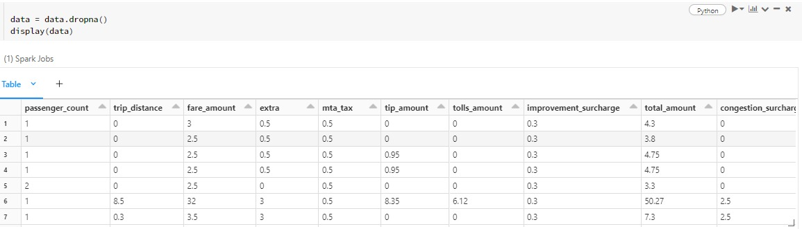
Data Preprocessing steps:
Checking Null Values : We can See there are No Null Values
Checking shape of data
Check for missing values
Display summary statistics of all variables.
Creating new columns
Dropping unwanted columns for better insights.
Drop-NA values.
DropNa:

Slide 7
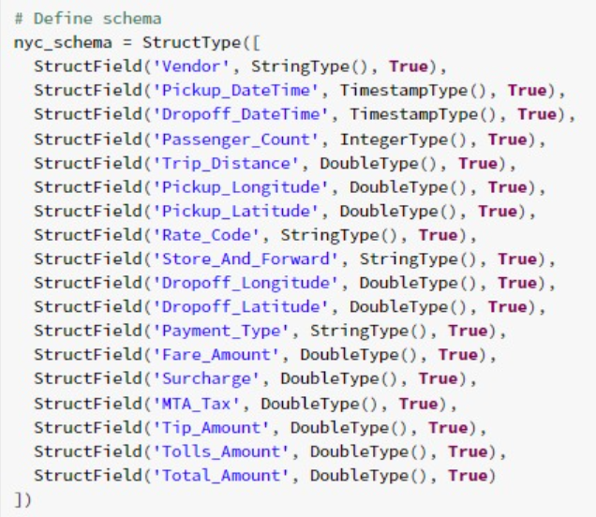
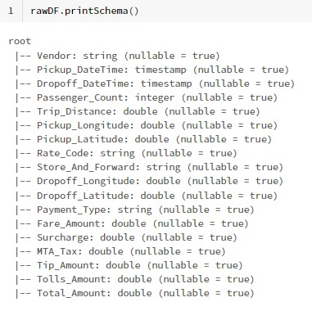
Data Type Schema:

Slide 8
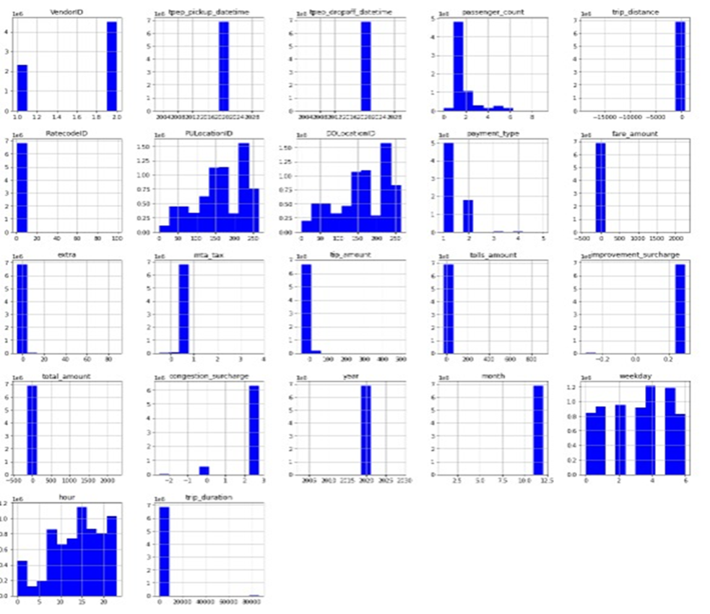
Data Visualization:
Frequency distribution of the various variables.
Providing a clear and concise way to visualize the distribution of the data and identify patterns and outliers.

Slide 9
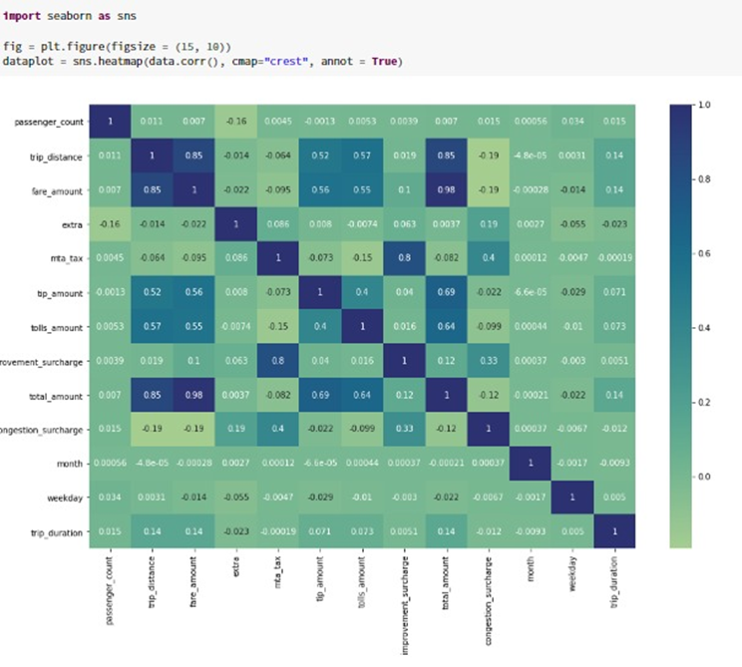
Correlation-Heat Map:
This correlation heatmap can be used to visualize the strength and direction of the linear relationship between pairs of variables, such as trip distance, trip time, fare amount, and so on.
We can see the maximum correlation between trip distance , Fare amount and Total Amount.

Slide 10
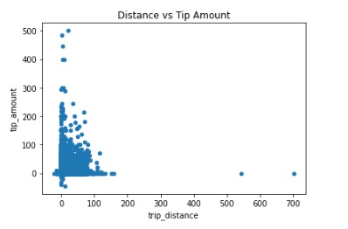
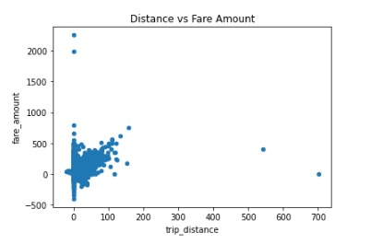
Data Visualization…

Slide 11
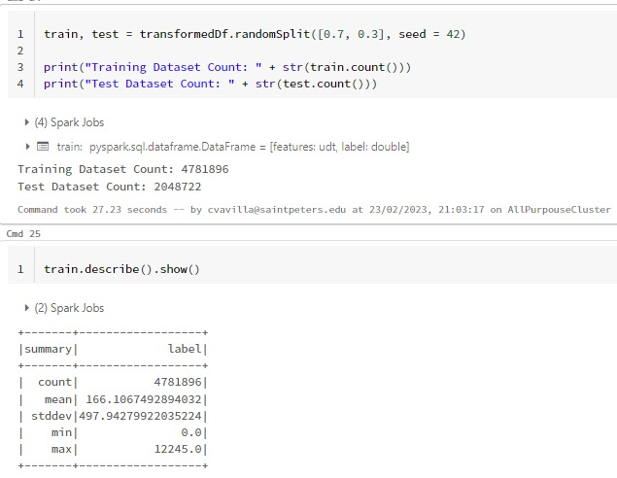
Train and Test Dataset:
Splitting the NYC taxi dataset into train and test sets

Slide 12
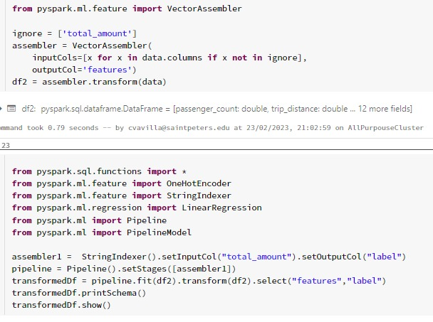
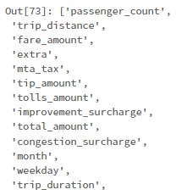
Feature and Label Columns:
Features:
Labels:Total amount

Slide 13
Machine Learning Models:
Linear Regression: Linear Regression is the supervised Machine Learning model in which the model finds the best fit linear trend between the feature and label variables.
Decision Tree Model: In decision tree classifiers, features in dataset represent nodes, decision nodes are used to make any decision and have multiple branches, whereas Leaf nodes are the output of those decisions.
Random Forest Regression: A random forest is an ensemble of decision trees, where each decision tree is trained on a random subset of the training data and a random subset of the features.

Slide 14
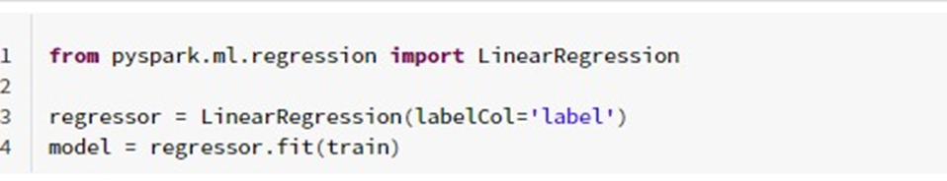
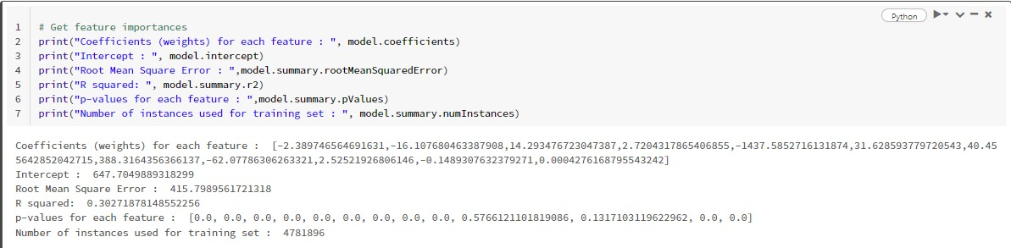
Linear Regression:
Results:
Root Mean Square Error: 415.7989
R squared: 0.31%

Slide 15
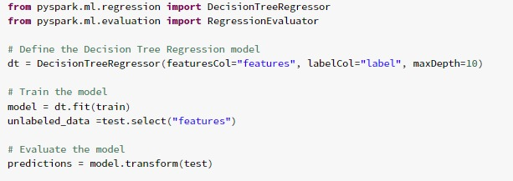
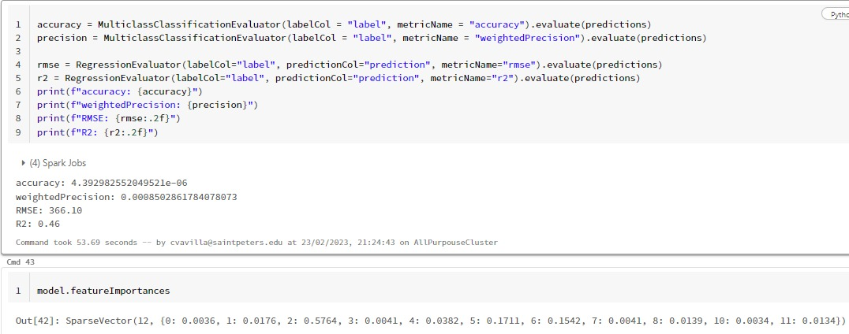
Decision Tree Model:
Results:
Accuracy: 4.392982552049521e-06
Precision: 0.0008502861784078073
RMSE: 366.10
R2: 0.46

Slide 16
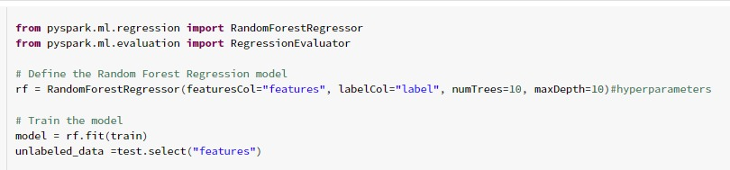
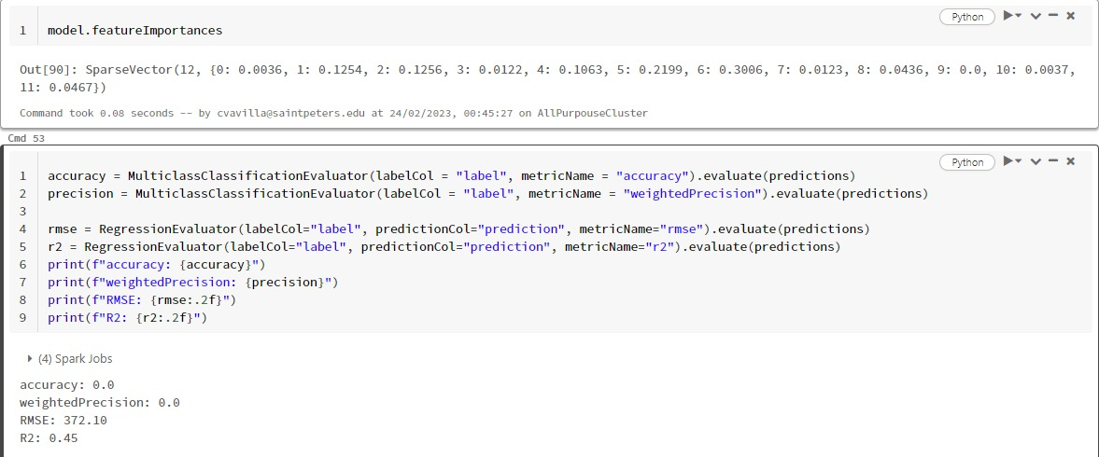
Random Forest Regression:
Results:
RMSE: 372.10
R2: 0.45

Slide 17
Summary Results:
Models | R2 | RMSE
Linear Regression | 0.31 | 415.80
Decision Tree Model | 0.46 | 366.10
Random Forest Model | 0.45 | 372.10
Cross Validator | 0.30 | 419.0
Though the applied models could not be able to predict total values accurately, however decision tree model has given comparatively good results with 46% of R2 and 366.10 is RMSE.

Slide 18
Conclusion:
In conclusion, the relationship between various attributes has become much clearer after an exploratory analysis of yellow taxi trip records. Though the models have not predicted the results accurately, we can develop a couple models to predict the other parameters. Additionally, with more precise weather data, we might be able to analyze how various weather conditions effect taxi activity in the future.
Overall, the model performed poorly since the prediction error is quite large, putting it a poor choice for making predictions.
Due to the complex and large dataset, we may have inconsistent data, highly volatile nature of the data, lack of weather conditions data, traffic information, inefficient resource allocation for taxi companies, drivers, and riders, and many more factors need to consider while predict the patterns by applying machine learning models for better accuracy.

Slide 19
Thank You

